Slide 1

Product analysis: from page view to purchase. How time affects our business

Slide 2
Agenda
Introduction
Average time for users to make a purchase
Page view and purchase comparison over time
User segments based on the amount of time to purchase
User purchase duration based on location
When do our users make purchases?
Conclusion and main analysis points

Slide 3
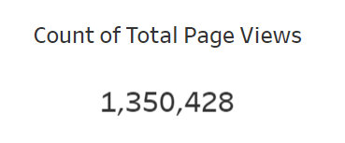
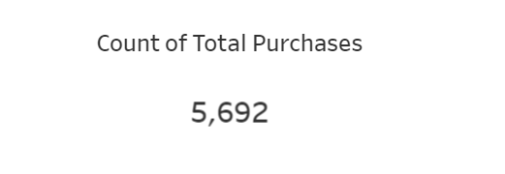
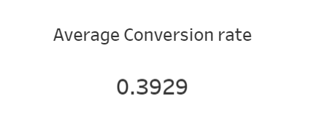
Introduction to the goals of this analysis
Context: The time it takes for users to make a purchase after their initial page view can significantly impact overall sales.
Quick purchase times often indicate a streamlined user experience and effective sales funnel, leading to higher conversion rates.
Conversely, longer purchase times may suggest user hesitation or obstacles in the purchasing process, which can negatively affect sales.
By analyzing purchase times, businesses can identify areas for improvement in their customer journey, optimize their marketing strategies, and ultimately enhance their sales performance. Understanding these dynamics helps in tailoring interventions to reduce purchase friction and boost revenue.

Slide 4
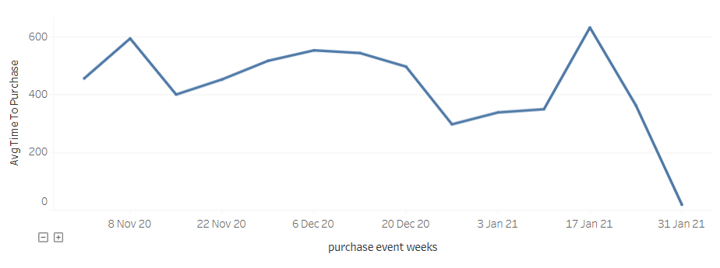
Average time for users to make a purchase
Variability in purchase time: There's a considerable fluctuation in purchase times, ranging from as low as 17.11 minutes on January 30, 2021, to over 150 minutes on January 20, 2021.
November 2020: Generally high average times, peaking around early November.
December 2020: A mix of high and low average times, with some particularly low averages around the end of December.
January 2021: Increased variability with both high peaks and low dips, indicating inconsistent user behavior.
P.S. this is a 3 month sample that might be slightly skewed due to holiday effects

Slide 5
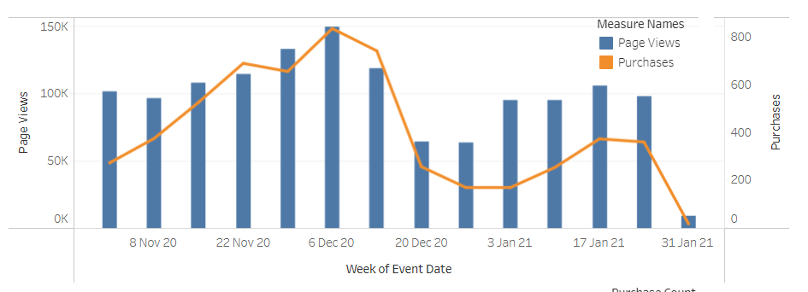
Page view and purchase comparison over time
Conversion rate: The overall conversion rate from page view to purchase was nearly 40% compared to an average of 2.5% for ecommerce businesses showing great results
Fluctuations: The conversion rate fluctuates significantly from day to day, indicating variability in user behavior and external factors affecting conversions.
The correlation coefficient between page views and purchases is approximately 0.82. This indicates a strong positive correlation, meaning that as the number of page views increases, the number of purchases also tends to increase.

Slide 6
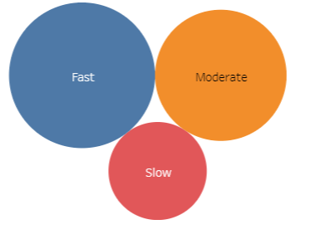
User segments based on the amount of time to purchase
Distribution of Users:
Fast segment: 2,117 users; average purchase time of 8.47 minutes
Moderate segment: 1,717 users; average purchase time of: 29.5 minutes
The Slow segment: 959 users; average purchase time of 286 minutes (due to some outliers too)
Strategic implications:
Fast Segment: These users are likely ready to purchase, so maintaining a smooth and quick checkout process is crucial. Consider offering incentives for quick purchases to further encourage this behavior.
Moderate Segment: These users might benefit from additional information, such as detailed product descriptions, reviews, or customer testimonials, to help them make quicker decisions.
Slow Segment: This group may require targeted interventions to reduce friction. Strategies could include retargeting ads, follow-up emails, live chat support, or offering time-sensitive discounts to prompt faster decisions.

Slide 7

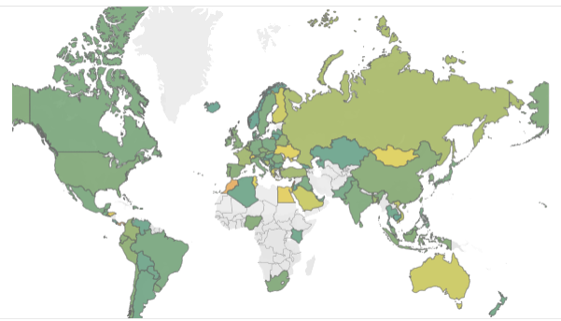
User purchase duration based on location
Europe: Countries like Lithuania and Norway have relatively short purchase times, whereas Belgium and France exhibit longer purchase times. This suggests variability within Europe, possibly influenced by local consumer behavior, digital literacy, and e-commerce infrastructure.
Asia: Countries like Qatar and Jordan show quick decision-making, while India, China, and Japan have longer purchase times. Cultural factors and the complexity of the e-commerce environment may influence these differences.
Americas: Costa Rica and Paraguay have shorter average times, while United States and Brazil fall into moderate categories. Canada shows longer purchase times, reflecting a more deliberate purchasing process.

Slide 8

Strategic Recommendations based on location data
Localized Strategies: Tailor marketing and user experience strategies to fit the specific behaviors and preferences of users in different countries.
Improve User Experience: For countries with longer purchase times, focus on improving the user interface and providing clear, concise information to reduce hesitation.
Targeted Promotions: Implement targeted promotions and discounts in countries with longer purchase times to encourage quicker decisions.
Analyze Barriers: Conduct deeper analysis to identify and address barriers in countries with very long purchase times, such as Armenia and Lebanon.

Slide 9

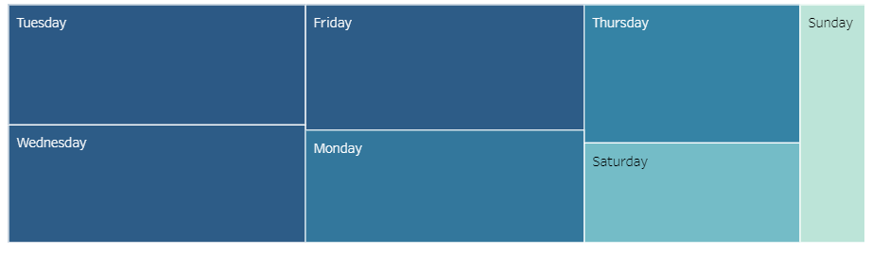
When do users make the purchases?
Context: Some data shows that Mondays are the most popular days to buy ecommerce products generally. In 2020 Wednesday and Thursday were the busiest retail days online for online sales, but that might be due to the pandemic. (see footnote for sources).
Fan Favorites: Tuesday, Wednesday, and Thursday. Tuesday, Wednesday, and Thursday have traditionally been favorite days to send email campaigns, as email marketers seek to avoid the Monday angst and Friday’s itchy-feet. MailChimp confirms that Tuesday and Thursday are the two most popular days to send email newsletters.
Our data: In our case Tuesday, Wednesday and Friday were the biggest sales days. Our focus should be on sending marketing campaigns on Tuesday and Wednesday.
Notes:
https://www.salecycle.com/blog/stats/when-are-people-most-likely-to-buy-online/ https://www.tailwindapp.com/blog/the-best-time-to-send-marketing-emails https://www.wordstream.com/blog/ws/best-time-to-send-email-campaign#:~:text=Tuesday%2C%20Wednesday%2C%20and%20Thursday%20have,days%20to%20send%20email%20newsletters.

Slide 10
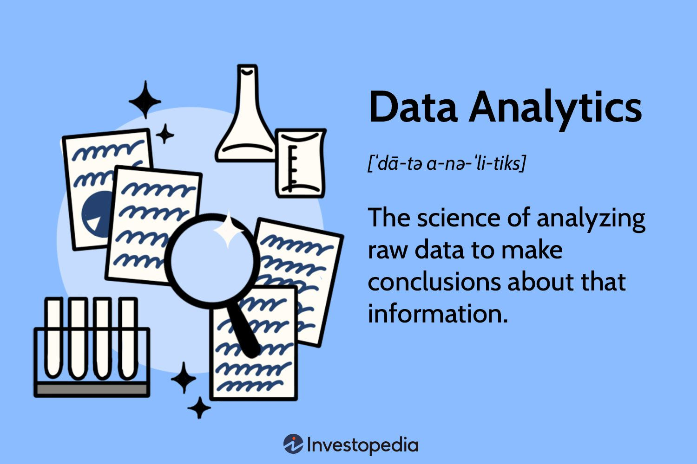
Conclusion and main analysis points
Overall trends and areas of focus:
Our overall purchase time seems to be decreasing suggesting improvements in the customer buying journey.
Our page views and purchases strongly correlate suggesting that marketing campaigns to attract users to our web are effective and can receive more investment
We should focus on releasing marketing emails and promotions on Tuesday and Wednesday
Our location targeting could me localized and detailed to reduce customer purchase times in some regions and countries
Targeting segments based on purchase speed/country average can provide interesting A/B campaigns for further UX and marketing improvements

Slide 11
Thank you for your attention and all questions are welcome now!

